Slide 1
Jacobson Methodology

Slide 2
Jacobson Methodology
OOSE is developed by Ivar Jacobson in 1992. OOSE is the first object-oriented design methodology that employs use cases in software design.
It covers entire life cycle and stress traceability between different phases
Advantage :-
Reduction of development time
Reuse of code
Reuse of analysis and design work

Slide 3
Use-Case
Use-Case is an interaction between user and the system.
Scenarios for understanding system requirements.
Use-case model captures the goal of the user and the responsibility of the system to its users.
Use Cases are described as :-
Nonformal text with no clear flow of events.
Text, easy to read but with a clear flow of events to follow
Formal style using Pseudo code.

Slide 4
Use- Case Description must contain the following :-
How and when the use case begins and ends
The interaction between the use case and its actors, including when the interaction occurs and what is exchanged.
How and when the usecase will need data stored in the system or will store data in the system.
Exceptions to the flow of events
How and when concepts of the problem domain are handled.

Slide 5
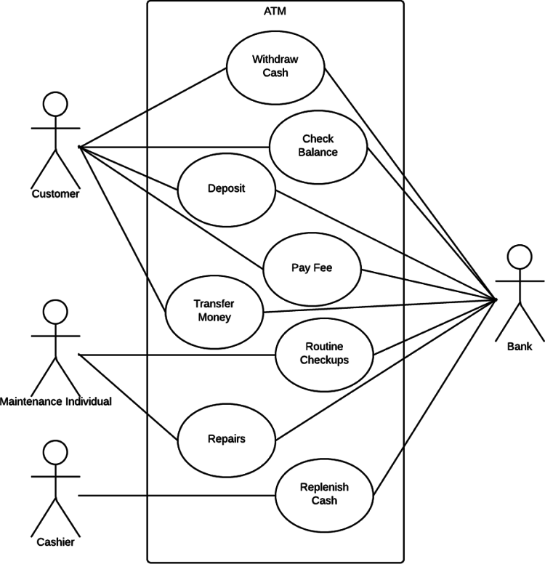
Sample Use-Case Diagram

Slide 6
Extends and Uses Relationship
Extends – used when you have one use case similar to another use case but does a bit more (Extends the functionality of original use case---sub class).
Uses – Reuses the common behavior in different use case.

Slide 7
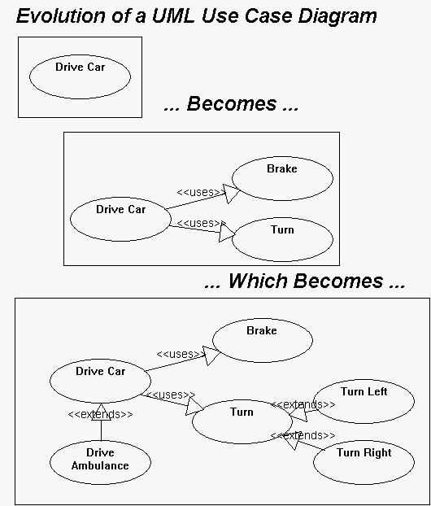

Slide 8
Use-Case Viewed as,
Use Case Viewed as Concrete or Abstract.
Abstract Use Case is:-
Not complete
Has no actors to initiate
But used by other use-case
It uses extends or uses relationship

Slide 9
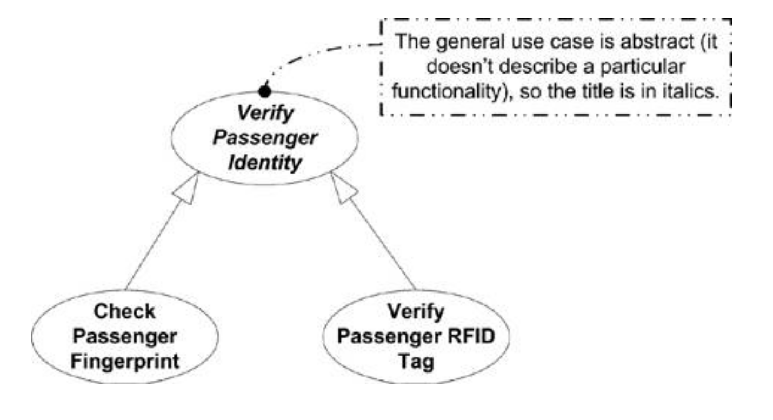

Slide 10
Object Oriented Software Engineering
Also called Objectory.
Objectory is built around several different models :-
Use case model → Defines the inside & outside of the system
Domain object model → Objects of “real world” are mapped into domain object
Analysis object model → how source code should be carried out & written
Implementation model → represent the implementation of the system
Test Model → constitute test plan, specification & report

Slide 11
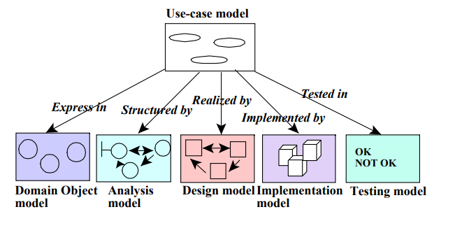

Slide 12
Object Oriented Business Engineering
Object Modeling at the enterprise level
Use Case serves as central vehicle for modeling, providing traceability throughout the software engineering process.
Software Engineering Process includes the following phases :-
Analysis phase
Design and Implementation phase
Testing phase

Slide 13
Assessment Questions
What are the object oriented methodologies available ?
Which is the widely used OO Methodology ?
Object-oriented Software Engineering is also know as _____ .
Requirement should be finalized before which phase in development ?
Use case can be viewed as______.

Slide 14
Assessment Questions & Answers
What are the object oriented methodologies available ? Rumbaugh, Booch, Jacobson
Which is the widely used OO Methodology ? Booch
Object- oriented Software Engineering is also know as Objectory
Requirement should be finalized before which phase in development ? Design Phase
Use case can be viewed as Concrete or Abstract.

Slide 16
The Unified Approach

Slide 17
The Unified Approach
Unified Approach “establishes a unifying framework by utilizing the UML diagram to describe, model and document the software development process”.
Idea :-
To stop evolution of another methodology.

Slide 18
Motivation :-
Combine best practices, methodologies, processes and guidelines along with UML diagrams for better understanding of OOPS concept & System development

Slide 19
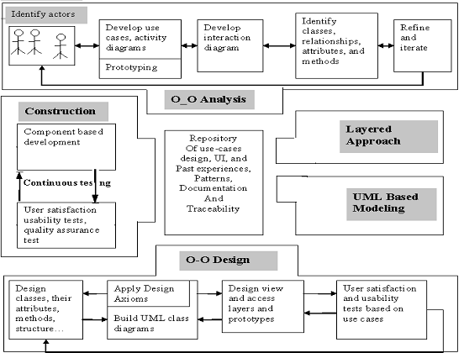
Fig : Process and Components of Unified Approach

Slide 20
Processes involved in Unified Approach
Use-case driven development
OO Analysis
OO design
Incremental Development and Prototyping
Continuous Testing

Slide 21
Methods and Technologies include
Unified Modeling Language for Modeling
Layered Approach
Repository OO System Development
Component-based development
It deviates from waterfall model since backtracking done between analysis and design phase [Iterative Development].

Slide 22
Object-Oriented Analysis
Analysis is the process of extracting the needs of a system and what the system must do to satisfy the users’ requirements.
The goal of object-oriented analysis is to first understand the domain of the problem and the system’s responsibilities by understanding how the users use or will use the system.
It concentrates on describing what the system does rather than how it does it.
View the system from the user’s perspective rather than that of the machine.

Slide 23
Contd,…
OOA process consists of the following steps:
1. Identify the Actors.
2. Develop a simple business process model
using UML Activity diagram.
3. Develop the Use Case.
4. Develop interaction diagrams.
5. Identify classes.

Slide 24
Object-Oriented Design
Booch, provides the most comprehensive object-oriented design method.
Rumbaugh et al.‘s and Jacobson et al.’s high-level models provide good avenues for getting started.
UA combines these by utilizing Jacobson et al.’s analysis and interaction diagrams, Booch’s object diagrams, and Rumbaugh et al.’s domain models.
Furthermore, by following Jacobson et al.’s life cycle model, we can produce designs that are traceable across requirements, analysis, design, coding, and testing

Slide 25
Contd,…
OOD Process consists of:
Designing classes, their attributes, methods, associations, structures and protocols, apply design axioms.
Design the Access Layer
Design and prototype User interface
User Satisfaction and Usability Tests based on the Usage/Use Cases
Iterated and refine the design

Slide 26
OOA to OOD

Slide 27
OOA to OOD

Slide 28
Iterative Development And Continuous Testing
You must iterate and reiterate until, eventually, you are satisfied with the system.
“ Testing uncovers design weaknesses “
During this iterative process, your prototypes will be incrementally transformed into the actual application.
The UA encourages the integration of testing plans from day 1 of the project.

Slide 29
Modeling Based on UML
The UA uses UML to describe and model the analysis and design phases of system development.
The Unified Modeling Language (UML) is, as its name implies, a modeling language and not a method or process.
UML is made up of a very specific notation and the related grammatical rules for constructing software models.

Slide 30
The UA Proposed Repository
Sharing eliminates duplication of Problem Solving.
Reusability.
Assembling Components from the Library.
Reduce the cost & development time.

Slide 31
The Layered Approach to Software Development

Slide 32
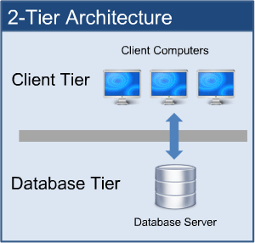
Two-Layered Architecture
LAYER 1 -- User Interface [User Interface + Business Logic]
LAYER 2 -- Database

Slide 33
Why Three-Layered Approach ?
Business Logic Resides in the screen.
Routines to access database too resides in the screen.
Here, Objects are specialized and are not reusable.
[Objects are tangible elements of your business]
Hence, Isolate the function of the interface from the function of the business – called three-layered approach.

Slide 34
Three-Layered Approach
OOD & Prototyping
OOA
OOA,OOD & Prototyping
Access Layer
Business Layer
View Layer

Slide 35
The User Interface (View) Layer
Consists of,
Objects with which the user interacts
Objects needed to manage or control the interface
Responsible for:-
Responding to user interaction → translate actions of user into business objects
Displaying business objects → paint the best possible picture of business object to user
View Layer Objects Created in OOA & OOD.

Slide 36
Business Layer
Responsibility :-
Model the objects of the business &
How the objects interact to accomplish the business processes.
Not Responsible for :-
Displaying details
No Knowledge of “how data will be displayed”. [Work of View Layer]
Data Access Details
No Knowledge of “where the data come from”.
Business Model Captures Static and Dynamic Relationships among a collection of business objects.

Slide 37
Access Layer
Access layer objects that know How to Communicate with the place where data actually resides.
Responsibilities:-
Translate Request –> translate any data related requests from the business layer into appropriate protocol for data access
Translate Response –> translate the data retrieved back into the appropriate business objects and pass onto business layer.
Access Layer Objects are identified in OOD Phase.

Slide 38
END OF MODULE Thank You !!!

